Slide 1
BLM1612 - Circuit Theory
Prof. Dr. Nizamettin AYDIN
naydin@yildiz.edu.tr
www.yildiz.edu.tr/~naydin
Capacitors
Inductors

Slide 2
Energy Storage Devices
Capacitors and Inductors

Slide 3
Objective of Lecture
Describe
the construction of a capacitor
how charge is stored.
Introduce several types of capacitors
The electrical properties of a capacitor
Relationship between charge, voltage, and capacitance; power; and energy
Equivalent capacitance when a set of capacitors are in series and in parallel
Describe
The construction of an inductor
How energy is stored in an inductor
The electrical properties of an inductor
Relationship between voltage, current, and inductance; power; and energy
Equivalent inductance when a set of inductors are in series and in parallel

Slide 4
Capacitors
Energy Storage Devices

Slide 5
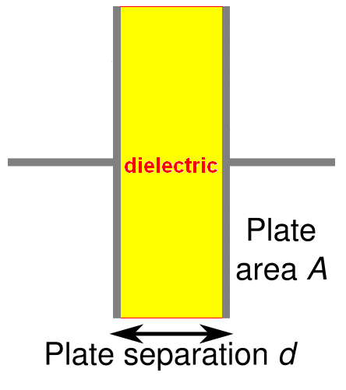
Capacitors
Composed of two conductive plates separated by an insulator (or dielectric).
Commonly illustrated as two parallel metal plates separated by a distance, d.
C = ε A/d
where ε = ε_{r} ε_{o}
ε_{r} is the relative dielectric constant
ε_{o} is the vacuum permittivity

Slide 6
Effect of Dimensions
Capacitance increases with
increasing surface area of the plates,
decreasing spacing between plates, and
increasing the relative dielectric constant of the insulator between the two plates.

Slide 7
Types of Capacitors
Fixed Capacitors
Nonpolarized
May be connected into circuit with either terminal of capacitor connected to the high voltage side of the circuit.
Insulator: Paper, Mica, Ceramic, Polymer
Electrolytic
The negative terminal must always be at a lower voltage than the positive terminal
Plates or Electrodes: Aluminum, Tantalum

Slide 8
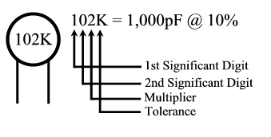

Nonpolarized
Difficult to make nonpolarized capacitors that store a large amount of charge or operate at high voltages.
Tolerance on capacitance values is very large
+50%/-25% is not unusual
PSpice Symbol
http://www.marvac.com/fun/ceramic_capacitor_codes.aspx

Slide 9
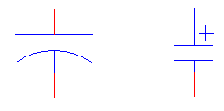
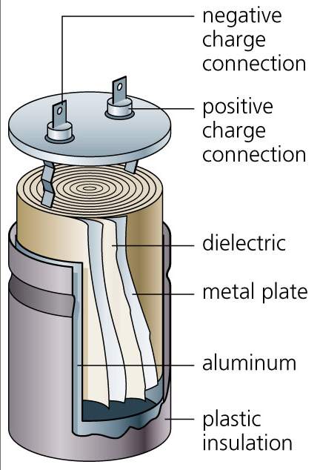
Electrolytic
Pspice Symbols
Fabrication
http://www.digitivity.com/articles/2008/11/choosing-the-right-capacitor.html

Slide 10
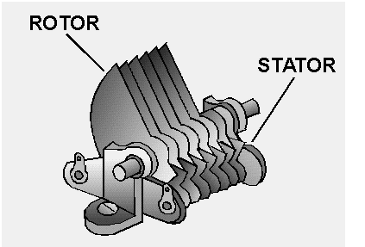

Variable Capacitors
Cross-sectional area is changed as one set of plates are rotated with respect to the other.
PSpice Symbol
http://www.tpub.com/neets/book2/3f.htm

Slide 11
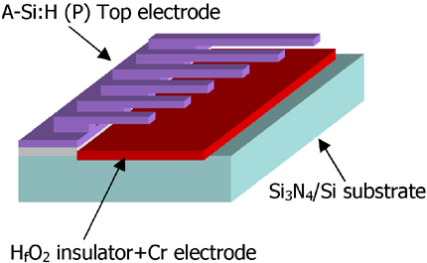
MEMS Capacitor
MEMS (Microelectromechanical system)
Can be a variable capacitor by changing the distance between electrodes.
Use in sensing applications as well as in RF electronics.
http://www.silvaco.com/tech_lib_TCAD/simulationstandard/2005/aug/a3/a3.html

Slide 12
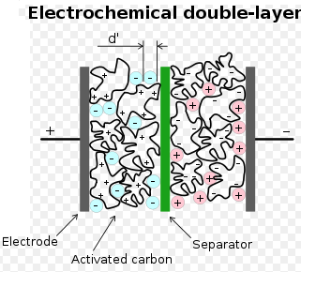
Electric Double Layer Capacitor
Also known as a supercapacitor or ultracapacitor
Used in high voltage/high current applications.
Energy storage for alternate energy systems.
http://en.wikipedia.org/wiki/File:Supercapacitor_diagram.svg

Slide 13
Electrical Properties of a Capacitor
Acts like an open circuit at steady state when connected to a d.c. voltage or current source.
Voltage on a capacitor must be continuous
There are no abrupt changes to the voltage
An ideal capacitor does not dissipate energy, it takes power when storing energy and returns it when discharging.

Slide 14
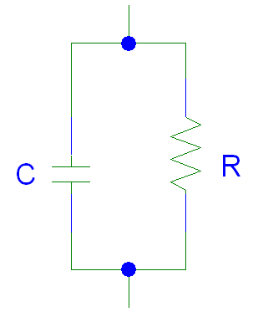
Properties of a Real Capacitor
A real capacitor does dissipate energy due to leakage of charge through its insulator.
This is modeled by putting a resistor in parallel with an ideal capacitor.

Slide 15
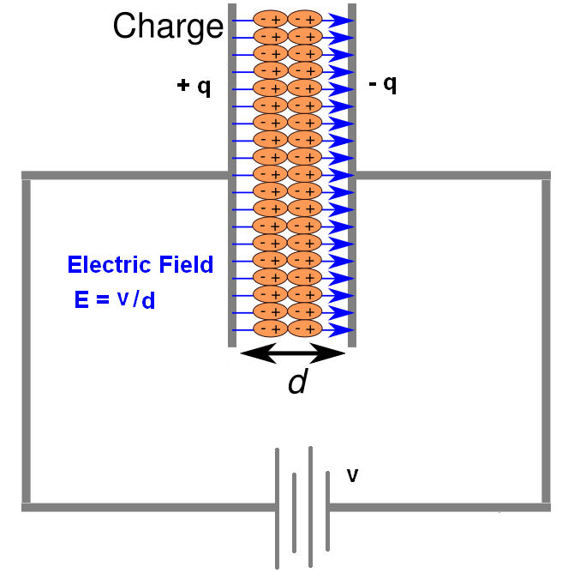
Energy Storage
Charge is stored on the plates of the capacitor.
Equation:
Q = CV
Units:
Coulomb = Farad.Voltage
C = F V

Slide 16
Adding Charge to Capacitor
The ability to add charge to a capacitor depends on:
the amount of charge already on the plates of the capacitor
and
the force (voltage) driving the charge towards the plates (i.e., current)

Slide 17
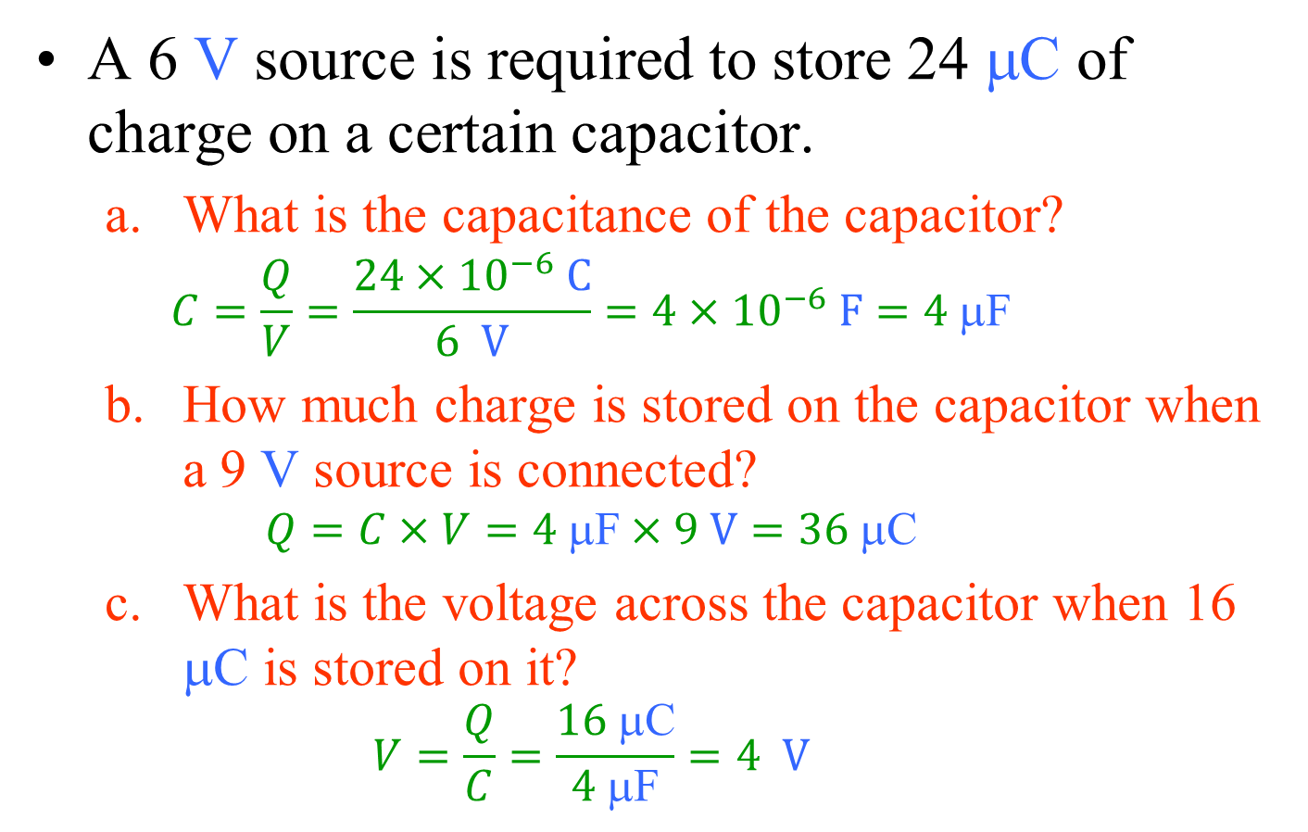
Example 01
A 6 V source is required to store 24 μC of charge on a certain capacitor.
What is the capacitance of the capacitor?
$$C=\frac{Q}{V}=\frac{24×{10}^{−6} C}{6 V}=4×{10}^{−6} F=4 \text{μ}\text{F}$$
How much charge is stored on the capacitor when a 9 V source is connected?
$$Q=C×V=4 \text{μ}\text{F}×9 V=36 \text{μ}\text{C}$$
What is the voltage across the capacitor when 16 μC is stored on it?
$$V=\frac{Q}{C}=\frac{16 \text{μ}\text{C}}{4 \text{μ}\text{F}}=4 V$$

Slide 18
Charging a Capacitor
At first, it is easy to store charge in the capacitor.
As more charge is stored on the plates of the capacitor, it becomes increasingly difficult to place additional charge on the plates.
Coulombic repulsion from the charge already on the plates creates an opposing force to limit the addition of more charge on the plates.
Voltage across a capacitor increases rapidly as charge is moved onto the plates when the initial amount of charge on the capacitor is small.
Voltage across the capacitor increases more slowly as it becomes difficult to add extra charge to the plates.

Slide 19
Discharging a Capacitor
At first, it is easy to remove charge in the capacitor.
Coulombic repulsion from the charge already on the plates creates a force that pushes some of the charge out of the capacitor once the force (voltage) that placed the charge in the capacitor is removed (or decreased).
As more charge is removed from the plates of the capacitor, it becomes increasingly difficult to get rid of the small amount of charge remaining on the plates.
Coulombic repulsion decreases as the charge spreads out on the plates. As the amount of charge decreases, the force needed to drive the charge off of the plates decreases.
Voltage across a capacitor decreases rapidly as charge is removed from the plates when the initial amount of charge on the capacitor is small.
Voltage across the capacitor decreases more slowly as it becomes difficult to force the remaining charge out of the capacitor.

Slide 20
Current-Voltage Relationships

Slide 21
Power and Energy

Slide 22
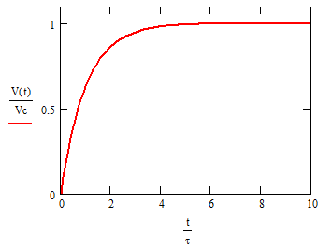
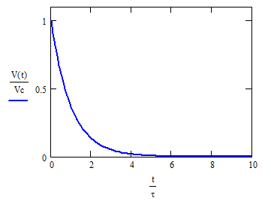
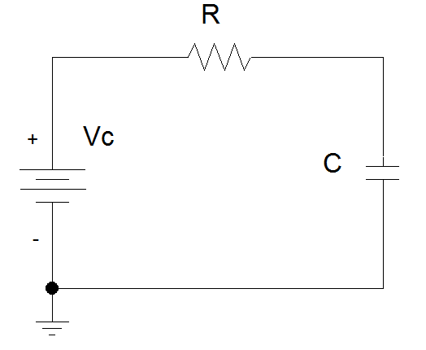
Capacitor Voltage vs. Time
d.c. voltage, Vc, is applied at t = 0s
d.c. voltage, Vc, is removed at t = 0s

Slide 23



Time constant, τ
The rate at which charge can be added to or removed from the plates of a capacitor as a function of time can be fit to an exponential function.
Charging Discharging

Slide 24
Transition to steady state
We approximate that the exponential function reaches its final value when the charging or discharging time is equal to 5τ.

Slide 25
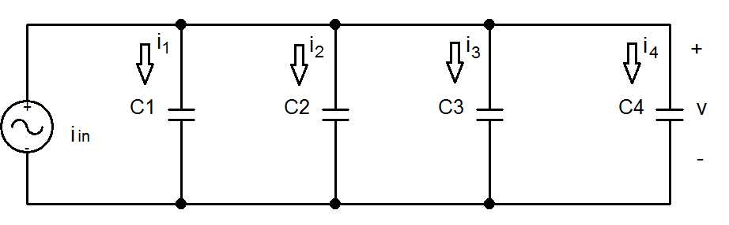
Equivalent Capacitance
Capacitors in parallel

Slide 26
C_{eq} for Capacitors in Parallel

Slide 27
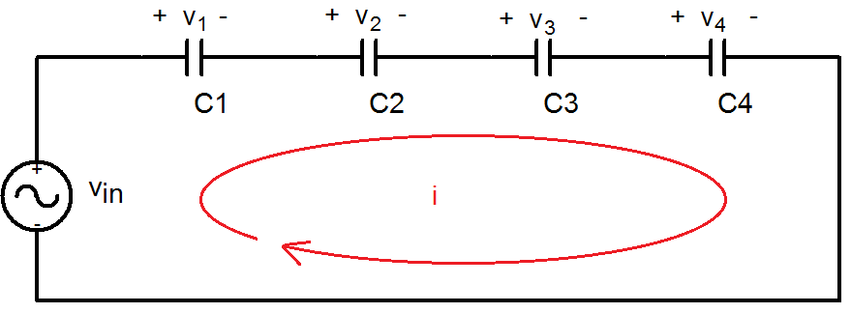
Equivalent Capacitance
Capacitors in series

Slide 28
C_{eq} for Capacitors in Series

Slide 29
General Equations for C_{eq}
Parallel Combination
Series Combination
If P capacitors are in parallel, then
If S capacitors are in series, then:

Slide 30
Summary
Capacitors are energy storage devices.
An ideal capacitor act like an open circuits when a DC voltage or current has been applied for at least 5 τ.
The voltage across a capacitor must be a continuous function; the current flowing across a capacitor can be discontinuous.
The equation for equivalent capacitance for
capacitors in parallel capacitors in series

Slide 31
Inductors
Energy Storage Devices

Slide 32
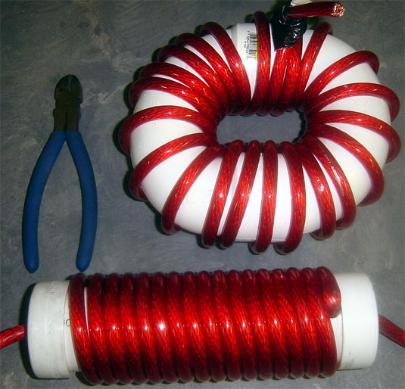
Inductors
Generally - coil of conducting wire
Usually wrapped around a solid core.
If no core is used, then the inductor is said to have an ‘air core’.
http://bzupages.com/f231/energy-stored-inductor-uzma-noreen-group6-part2-1464/

Slide 33
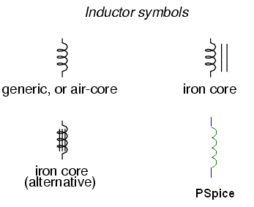

Symbols
http://www.allaboutcircuits.com/vol_1/chpt_15/1.html

Slide 34
Alternative Names for Inductors
Reactor
inductor in a power grid
Choke
designed to block a particular frequency while allowing currents at lower frequencies or d.c. currents through
Commonly used in RF (radio frequency) circuitry
Coil
often coated with varnish and/or wrapped with insulating tape to provide additional insulation and secure them in place
A winding is a coil with taps (terminals).
Solenoid
a three dimensional coil.
Also used to denote an electromagnet where the magnetic field is generated by current flowing through a toroidal inductor.

Slide 35
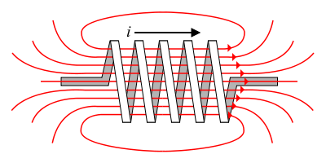
Energy Storage
The flow of current through an inductor creates a magnetic field (right hand rule).
If the current flowing through the inductor drops, the magnetic field will also decrease and energy is released through the generation of a current.
B field
http://en.wikibooks.org/wiki/Circuit_Theory/Mutual_Inductance

Slide 36
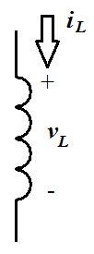
Sign Convention
The sign convention used with an inductor is the same as for a power dissipating device.
When current flows into the positive side of the voltage across the inductor, it is positive and the inductor is dissipating power.
When the inductor releases energy back into the circuit, the sign of the current will be negative.

Slide 37
Current and Voltage Relationships
L , inductance, has the units of Henries (H)
1 H = 1 V-s/A

Slide 38
Power and Energy

Slide 39
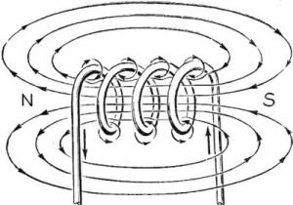
Inductors
Stores energy in an magnetic field created by the electric current flowing through it.
Inductor opposes change in current flowing through it.
Current through an inductor is continuous; voltage can be discontinuous.
http://www.rfcafe.com/references/electrical/Electricity%20-%20Basic%20Navy%20Training%20Courses/electricity%20-%20basic%20navy%20training%20courses%20-%20chapter%2012.htm

Slide 40
Calculations of L
For a solenoid (toroidal inductor)
N is the number of turns of wire
A is the cross-sectional area of the toroid in m².
μ_{r} is the relative permeability of the core material
μ_{o} is the vacuum permeability (4π × 10⁻⁷ H/m)
l is the length of the wire used to wrap the toroid in meters

Slide 41
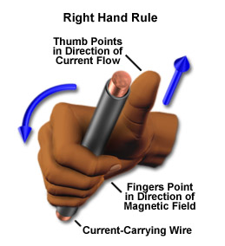
Wire
Unfortunately, even bare wire has inductance.
d is the diameter of the wire in meters.

Slide 42
Properties of an Inductor
Acts like an short circuit at steady state when connected to a d.c. voltage or current source.
Current through an inductor must be continuous
There are no abrupt changes to the current, but there can be abrupt changes in the voltage across an inductor.
An ideal inductor does not dissipate energy, it takes power from the circuit when storing energy and returns it when discharging.

Slide 43
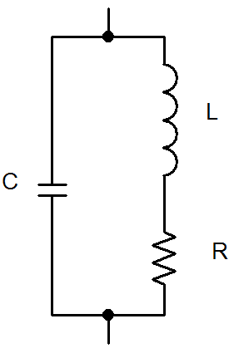
Properties of a Real Inductor
Real inductors do dissipate energy due to resistive losses in the length of wire and capacitive coupling between turns of the wire.

Slide 44
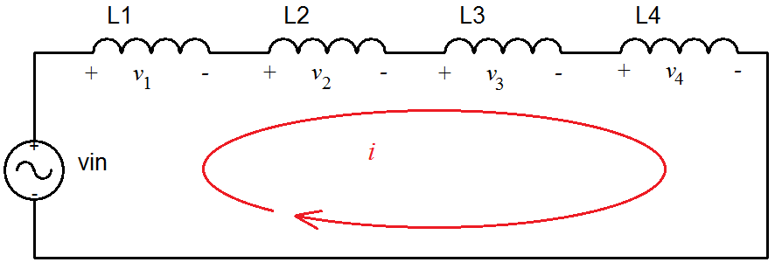
Inductors in Series

Slide 45
L_{eq} for Inductors in Series

Slide 46
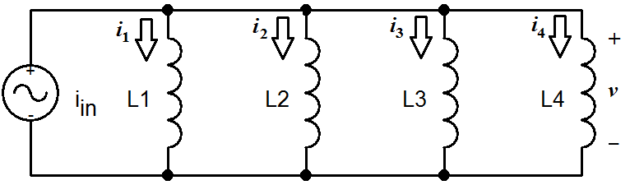
Inductors in Parallel

Slide 47
L_{eq} for Inductors in Parallel

Slide 48
General Equations for L_{eq}
Series Combination
Parallel Combination
If S inductors are in series, then
If P inductors are in parallel, then:

Slide 49
Summary
Inductors are energy storage devices.
An ideal inductor act like a short circuit at steady state when a DC voltage or current has been applied.
The current through an inductor must be a continuous function; the voltage across an inductor can be discontinuous.
The equation for equivalent inductance for
inductors in series inductors in parallel

